Slide 1
Early Warnings for All in Asia Pacific:
Transboundary Context
18 Integrated Workshop / 4th TRCG Forum
ESCAP/WMO Typhoon Committee
Sanjay Srivastava
28 November 2023, UNCC, Bangkok
Chief of Disaster Risk Reduction, ESCAP

Slide 2

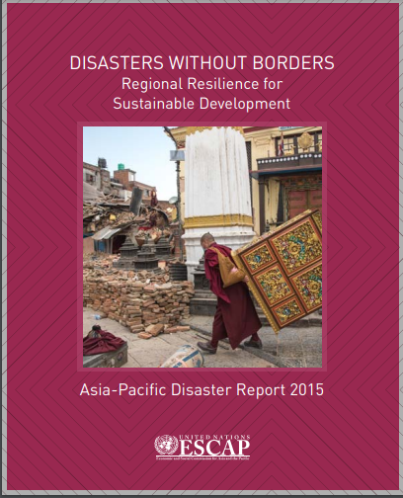
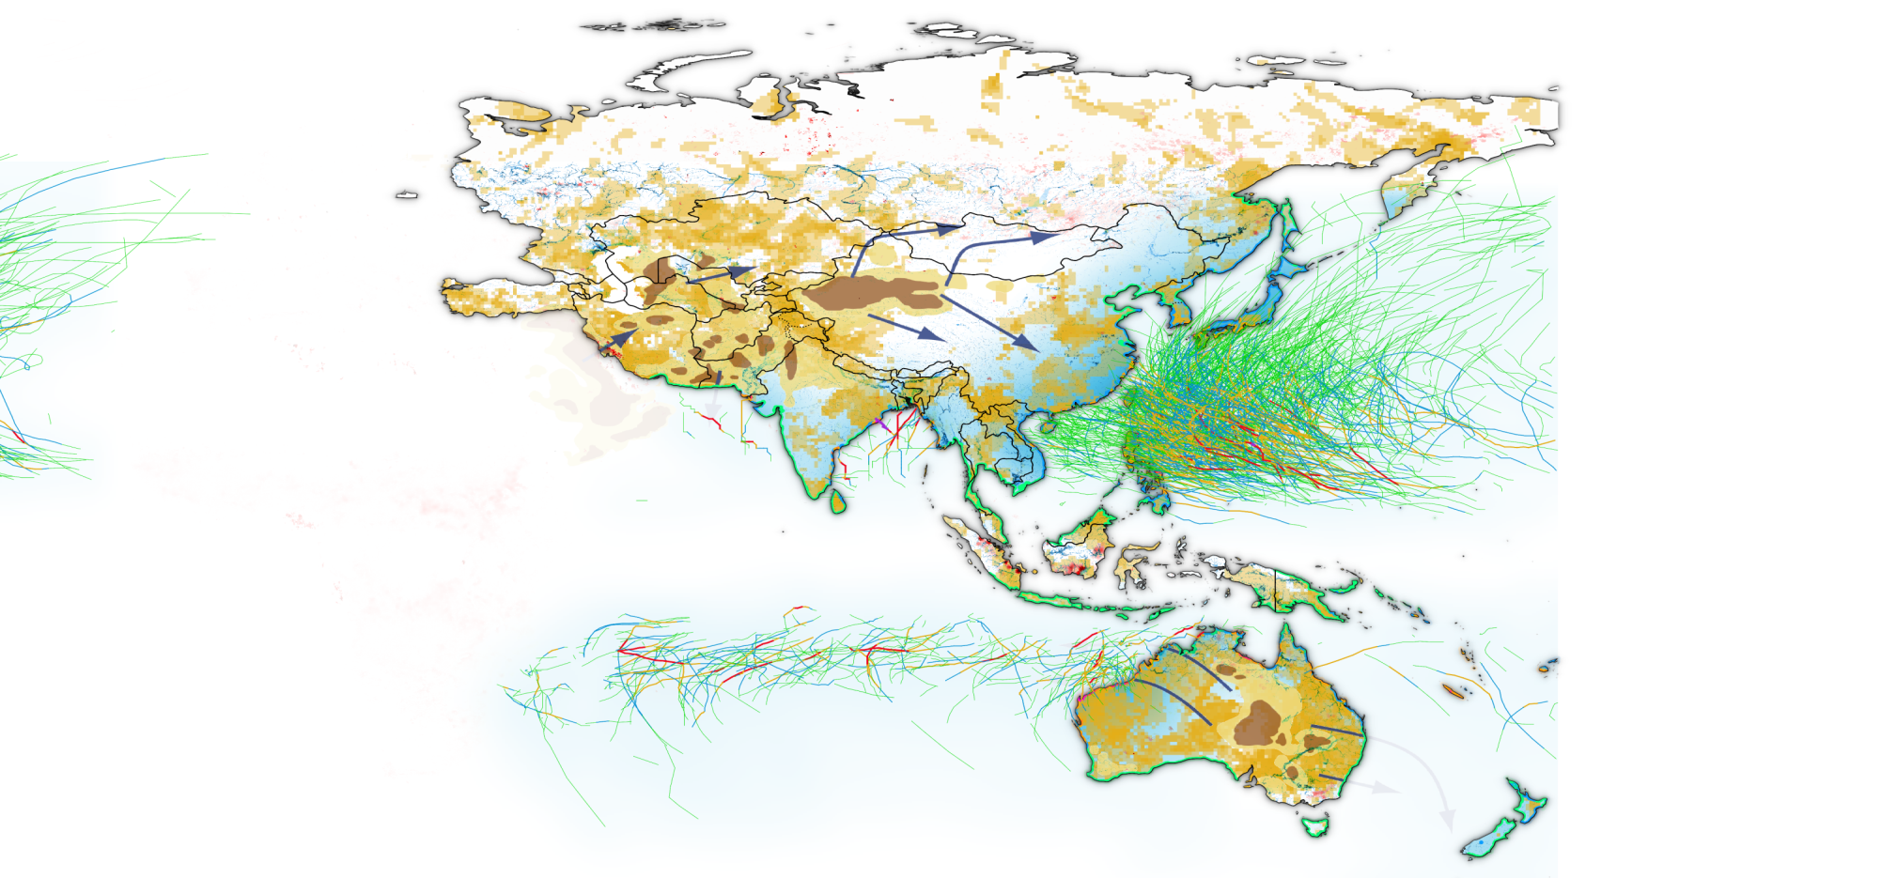
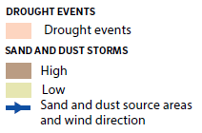
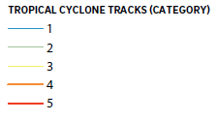
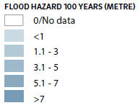
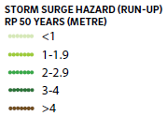
Disaster risks often have transboundary origins and impacts
Sources: ESCAP, based on Global Assessment Report on Disaster Risk Reduction (GAR) Risk Atlas, 2015; Global Risk Data Platform, 2013; Muhs, and others, 2014. Disclaimer: The boundaries and names shown and the designations used on this map do not imply official endorsement or acceptance by the United Nations. Dotted line represents approximately the Line of Control in Jammu and Kashmir agreed upon by India and Pakistan. The final status of Jammu and Kashmir has not yet been agreed upon by the parties.”

Slide 3
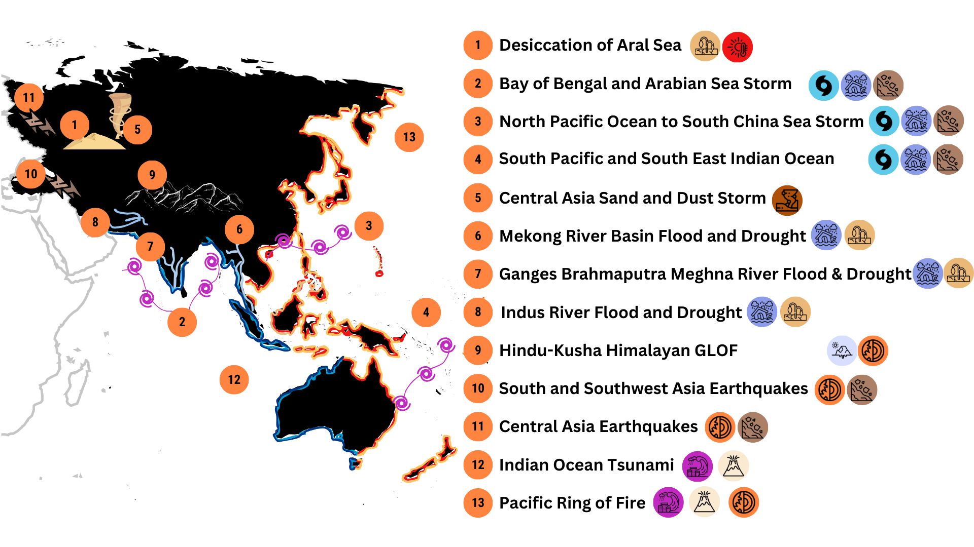
Transboundary Hazard in the AP region
Notes:
ASEAN countries exposure to drought (2℃ SSP3) to hydroelectric plant

Slide 4

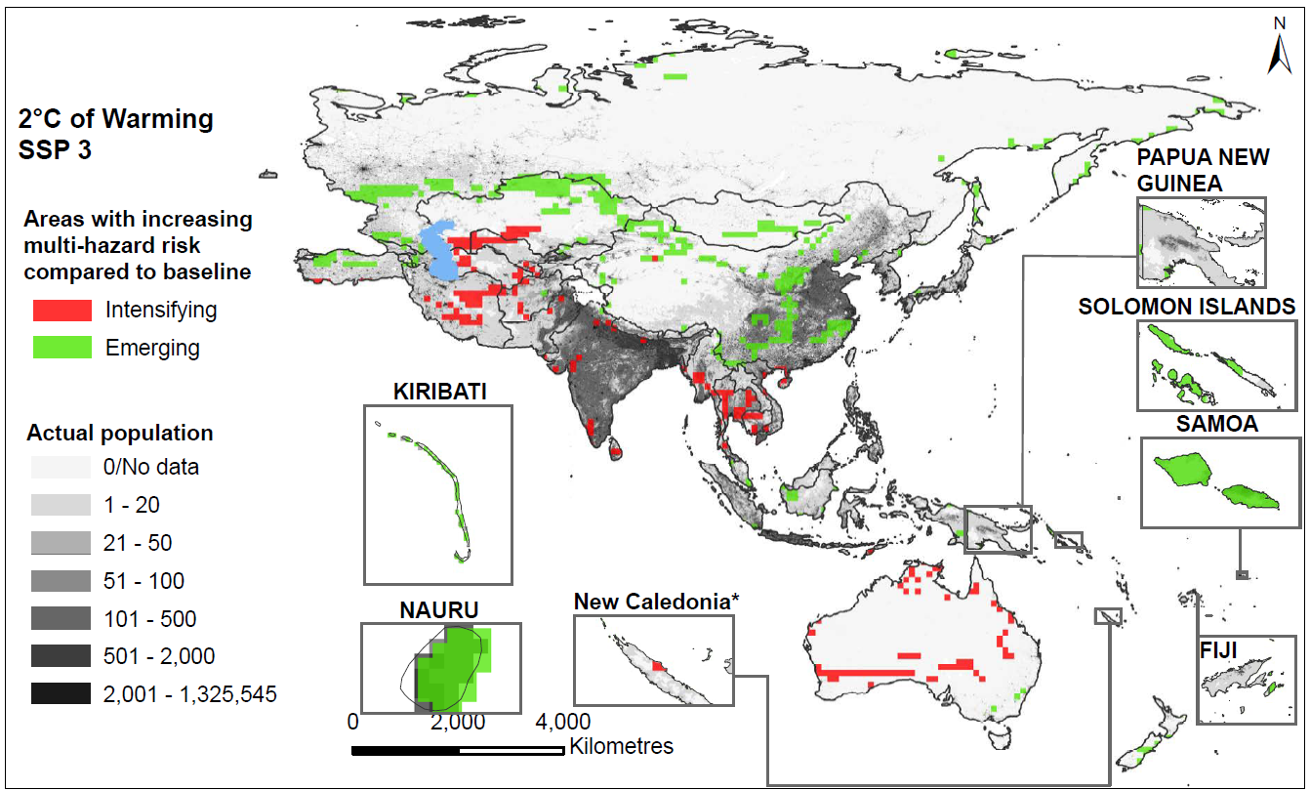
Emerging and intensifying risk hotspots: Population exposed under 1.5 ℃ and 2 ℃ warming scenarios compared to baseline
Notes:
ASEAN countries exposure to drought (2℃ SSP3) to hydroelectric plant

Slide 5
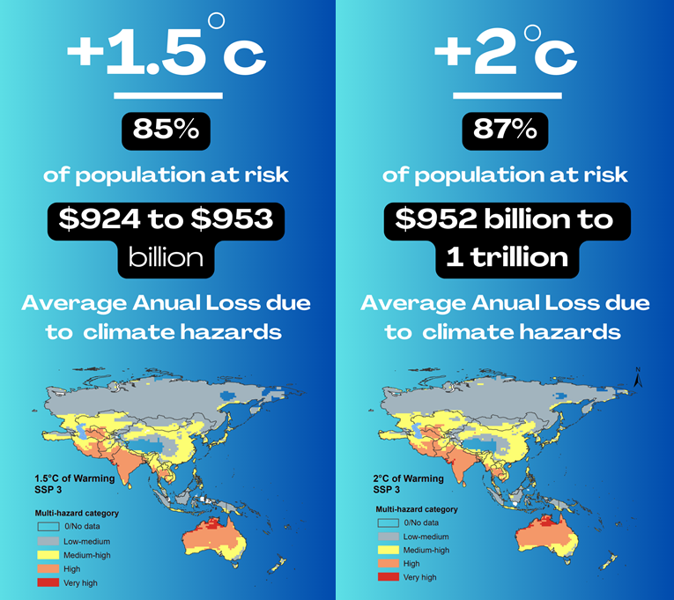
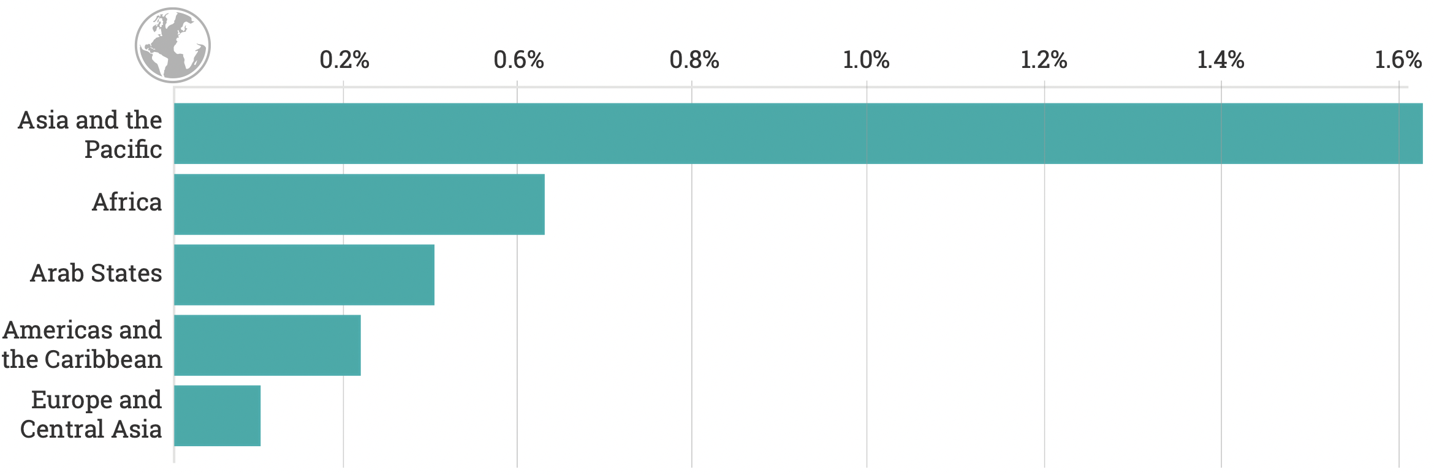
Why EW4All is so critical in Asia Pacific?
Asia Pacific remains the most disaster impacted region. Since 1970, two million people have lost their lives, equivalent to 105 lives being lost to disasters every day.
The LDCs/SIDS accounts for mortality five times as compared to the rest of the Asia Pacific
The cost of inaction is on the rise, regression on SDG 13, Sendai targets off the tracks
A Riskscape@1.5 and 2.0 warming:
Intensifying and emerging hotspots
The highest share of economic loss by region is borne within Asia Pacific, where countries lose on average 1.6% of GDP to disasters.
(Source: GAR 2021)
Notes:
As suggested by the Editorial Board, APDR 23 starts with the guiding question – Why act now?
To respond to this question – we went half a century back to capture the historical trend of disasters.
This trend reveals climate variability and no more relevant with changing climate.
We looked 50 years ahead – with climate scenarios of 1.5- and 2.0-degree warming.
It’s an era of a disaster emergency and we must act now.

Slide 6
‘Early Warning for All’ protects at risk - people, sectors and systems, and reduces annual losses from hydromet disasters by over $115 billion
#1. Protect people at risk in multi-hazard risk hotspots, Focus on most vulnerable in intensifying and emerging risk hotspots
01
#2. Economic case of EW4ALL:
10-fold returns on investments,
triples the benefits in
vulnerable context
04
People @
risk in the center
02
#4 Nature-based solutions (NbS) to sustainably manage, protect and restore the degraded environment and reduce disaster risk.
Around 40% of climate action can be achieved through nature-based solutions
#3. Sector specific early warnings-Key to safeguard
food and energy systems in highly exposed high risk developing, SIDS and LDCS-Reduces economic loss by 20-60 percent
03

Slide 7
Also, Early warnings capacity gaps are critical in high risk developing countries, LDCs, SIDS
Multi-hazard early warning capacity
Access # 25% countries to multi-hazard early warning systems; 20 to ‘actionable’ risk information
A comprehensive risk management approach to ensure resilient food and energy systems
G-1 | G-2 | G-3 | G-4 | G-5
Have MHEWS | MH monitoring & forecasting | EW dissemination coverage | Local plan of action on EW | Publicly available disaster risk info
Notes:
Given the level of exposure (both intensifying and emerging), the level of early warning system as reported by the Sendai Framework target G shows wide variations between countries, especially on multi hazard monitoring and forecasting (G2) where as many countries reported having limited as those reported to have limited level of capability

Slide 8


ESCAP’s Mandate to support EW4All
Regional Strategy on Early Warnings for All
1
Develop early warning systems for all at the regional level
ESCAP Resolution 79/1: Accelerating climate action for sustainable development (May 2023)
Further develop and implement a regional strategy in support of the global and country-level implementation of the four pillars of multi-hazard early warning systems
ESCAP Committee on Disaster Risk Reduction (July 25-27, 2023)
2
3
Build national capacities by leveraging innovations, including digital and geospatial applications for early warning systems
ESCAP Committee on Disaster Risk Reduction (July 25-27, 2023)
ESCAP Multi-Donor Trust Fund for Tsunami, Disaster and Climate Preparedness
20th Anniversary of Indian Ocean Tsunami and contributions to ESCAP Trust fund to achieve early warnings for all
ESCAP Committee on Disaster Risk Reduction (July 25-27, 2023)
4

Slide 9
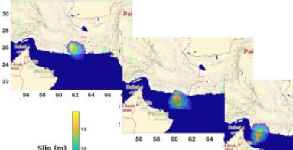
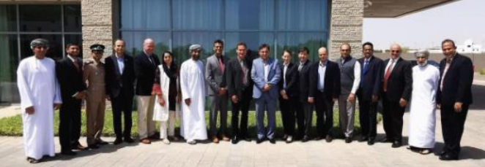
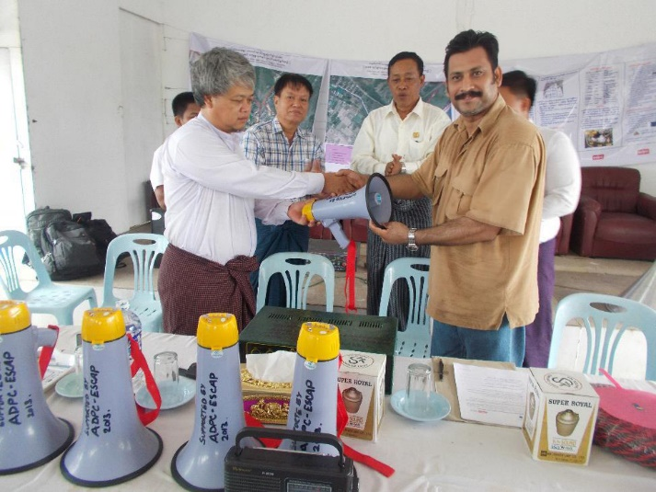

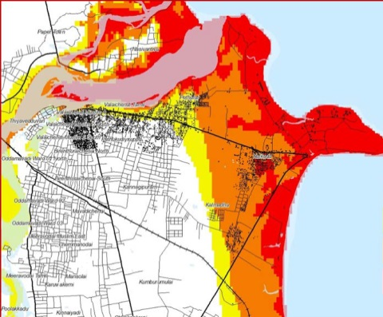
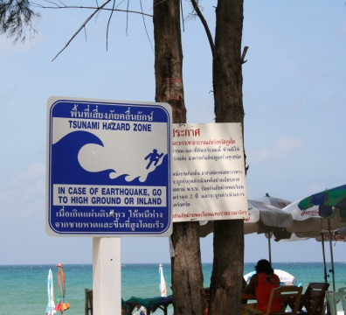
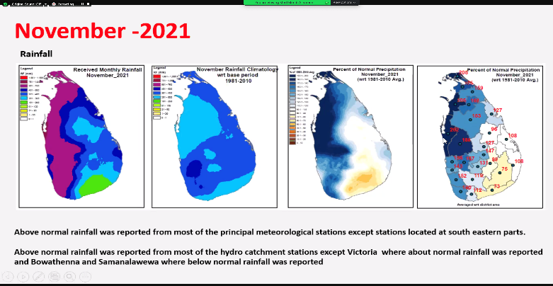
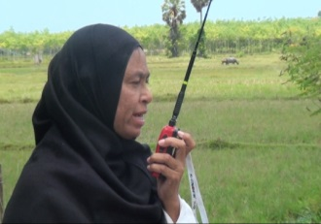
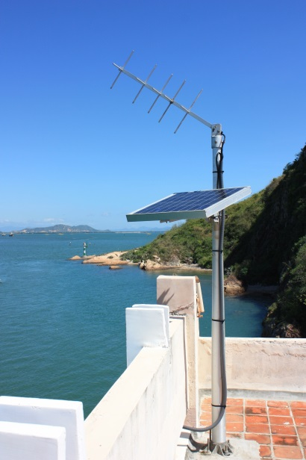
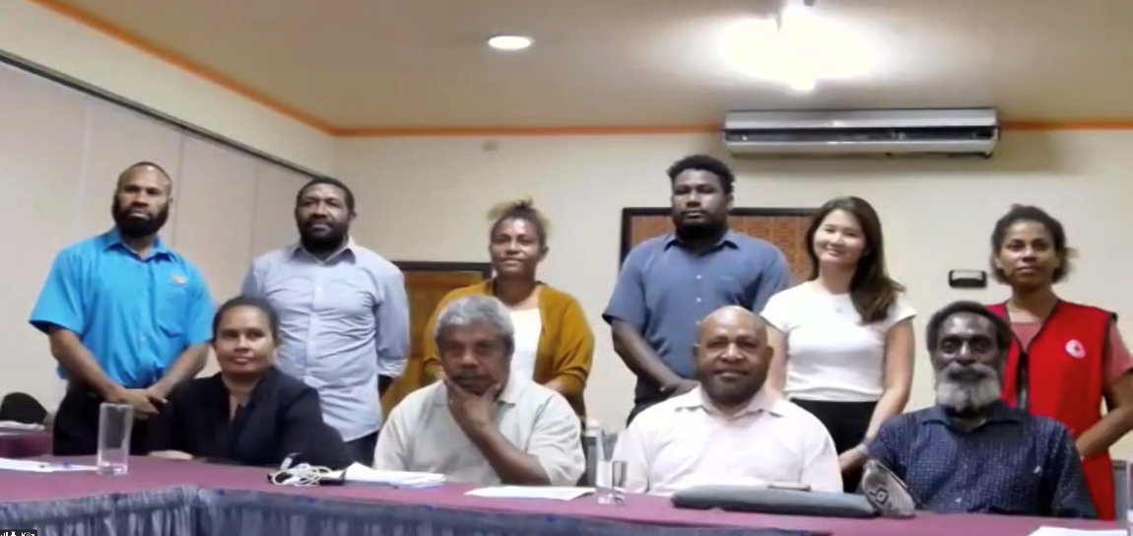

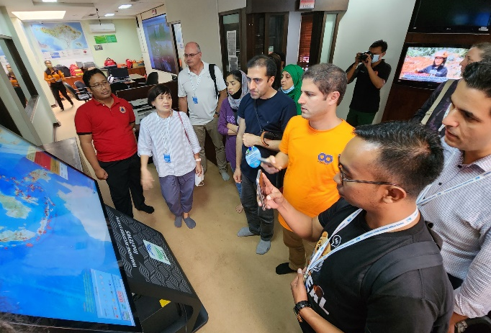
ESCAP Multi-donor Trust Fund: 18 years of support to Early Warning Systems
e.g. Probabilistic Tsunami Hazard Assessment for the Northwest Indian Ocean
e.g. Broadcasting and media support for early warning
e.g. ‘Last Mile’ government, community and stakeholder SOPs
e.g. National Monsoon / Climate Outlook Forums

Slide 10
A regional strategy for seamless integration
of national and transboundary EWS
Effectiveness of EWS/MHEWS:
Policy, plans and financial mechanisms that enable availability and accessibility of EWS/MHEWS
Accessibility of EWS/ MHEWS
Coverage through tele-density
Availability of EWS and MHEWS,
Unmet needs
National/sub-national EWS
Transboundary EWS
Co-operation
Understanding transboundary origins and impacts of multi--hazard risks
Disaster risk is often transboundary that needs to factor in while configuring the EW4All
Transboundary EWS/MHEWS,
Regional/sub-regional co-operation mechanism
Context of risk
and vulnerabilities:
Identify
@ risk population in
multi-hazard areas
Replication of Typhoon Committee for other hazards

Slide 11
Transboundary Risks & Impacts
Population & Sector Exposure
EWS Capacities
EWS Gaps & Opportunities
Regional Strategy on Early Warnings for All
The Regional strategy for EW4All will aim lay out the pathway to transboundary resilience.
First, to outline the impacts of key transboundary hazards to at-risk populations and sectors, and the future exposures under an evolving climate.
Then will analyze the current transboundary early warning systems and present the opportunities for regional cooperation to advance the shared EWS, ensuring no one and no sector is left behind.
These gaps will anchor the priority programmes for the future of the Trust Fund.
Notes:
The Regional strategy for EW4All will aim lay out the pathway to transboundary resilience, just as the region, supported by the Trust Fund has been able do for Tsunamis. Firstly, to outline the impacts of key transboundary hazards to at-risk populations and sectors, and the future exposures under an evolving climate. Then will analyze the current transboundary early warning systems and present the opportunities for regional cooperation to advance the shared EWS, ensuring no one and no sector is left behind. These gaps will anchor the priority programmes for the future of the Trust Fund.

Slide 12
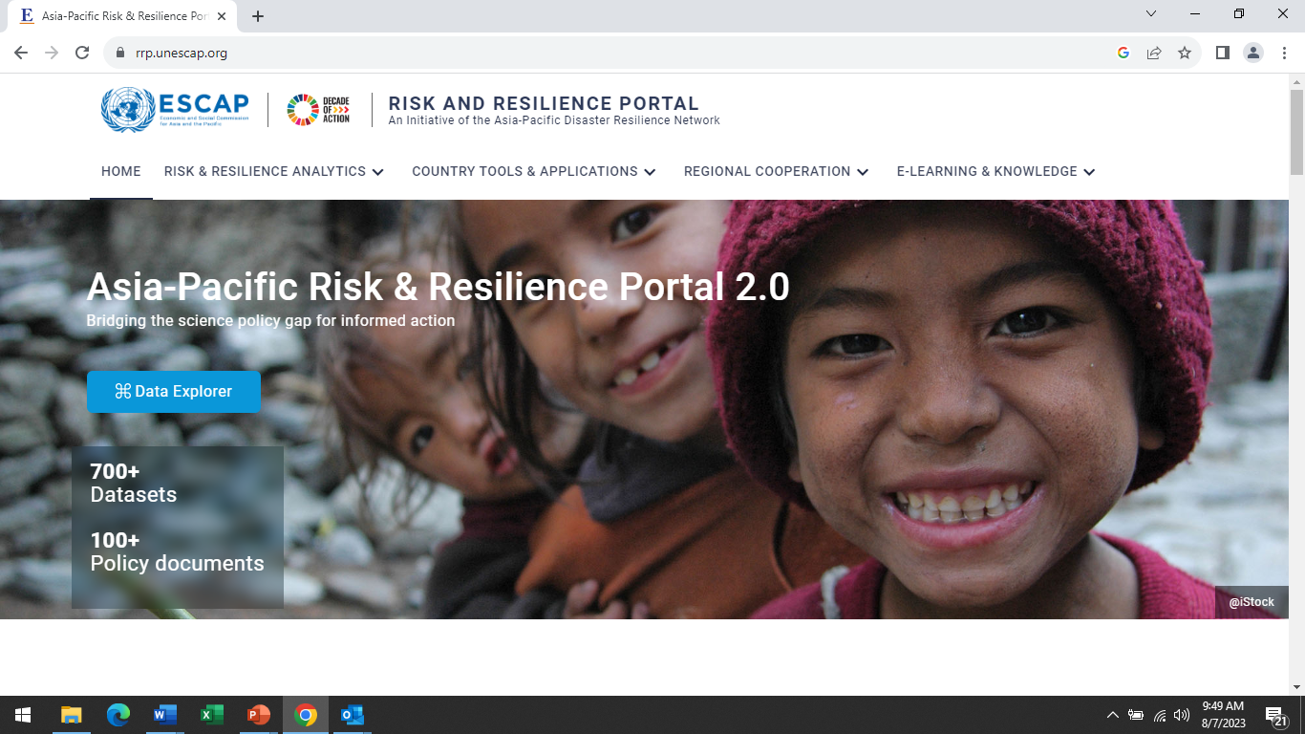
ESCAP’s Offer of Support to EW4All​
Risk knowledge and impact forecasting from transboundary EWS perspectives
Partnering with stakeholders –Government of Nepal, UN System, Global Leads, RIMES, ICIMOD, UK Met Office..
Analytical work: Asia Pacific Disaster Report for South Asia with specific focus on risk-impact-policy response and transboundary co-operation
Digitalization: Customization of ESCAP’s Risk and Resilience Data platform to enhance risk knowledge, impact forecasting in Nepal – organize specialist training
Transboundary EWS:
Strengthen building blocks of regional initiatives, integrate impact forecasting, anticipatory actions and South Asia SDG forum

Slide 13
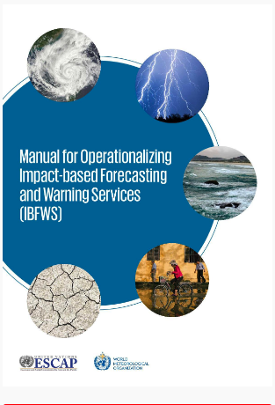
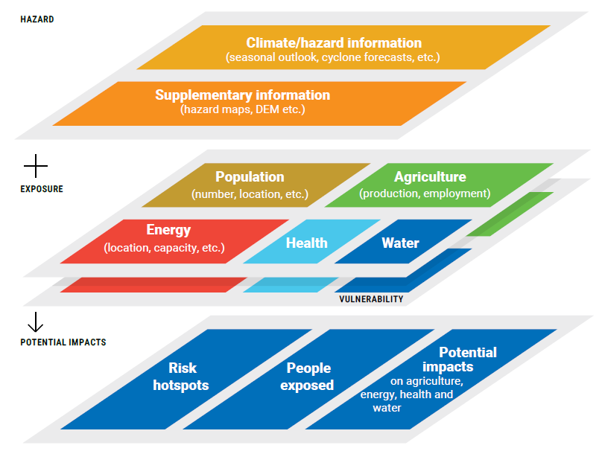
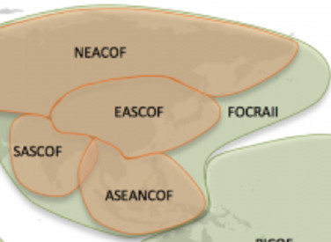
ESCAP’s Support to Pillar 2: Observations and Forecasting
Translating consensus outlook
to impact forecasting
Climate Outlook Forums (ASEAN, FOCRII, SASCOF) – consensus seasonal outlook to impact forecasting – key sectors – DRR (people, food, water, energy and health sectors)

Slide 14

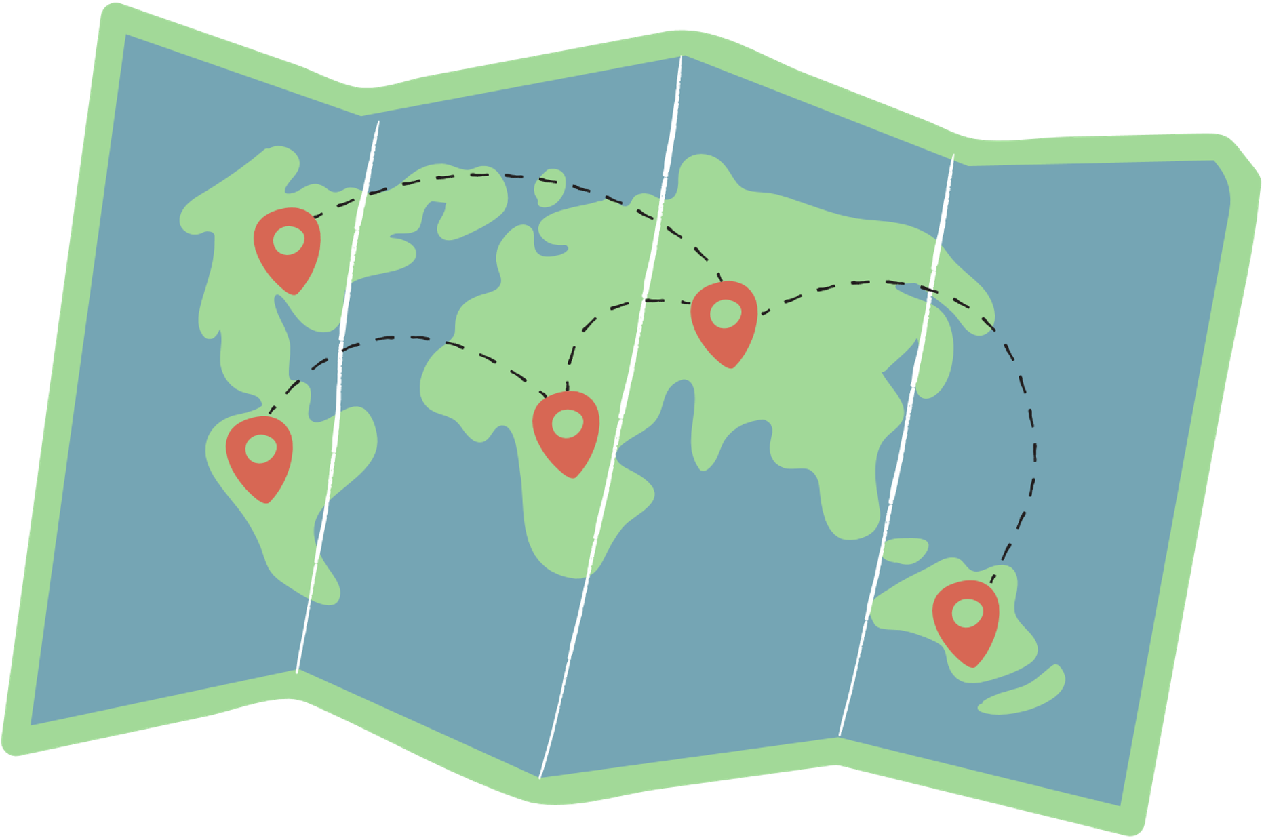




Automated seasonal impact-based forecasting
USER INPUT*
OUTPUT
  Population data
  Infrastructure data
  Hazard data
  Boundary data
  Exposure and intensity zone of hazards
  Map & exportable table
GEOSPATIAL PYTHON AUTOMATION SCRIPT
GEOSPATIAL PRE-PROCESSING
PROCESS IDENTIFICATION
GEOSPATIAL EXPOSURE ANALYSIS
  Setting Coordinate Reference Systems
  Setting resolution
  Classifying hazard (based on intensities, create different hazard intensity zones)
  Auto recognize type of infrastructure / population data
  Calculate exposure to all infrastructure and population
  Overlay & count exposure
Notes:
Despite a clear approach, the path to assessing the impact is not straight-forward. It requires spending loads of resources, time and space on data analysis and computing on powerful machines which can handle heavy processing tasks and can only be done using advanced skills on geospatial tools and analysis techniques.
Addressing this issue, we have built the automated seasonal impact-based forecasting tool, where anyone can use the hazard, infrastructure, population and administrative boundary data to perform the exposure analysis and get the results without any hassle swiftly.

Slide 15
Verification of the SASCOF OND 2023 IBF percent exposure from automation tool with the manual calculations on QGIS
Country | Method | BELOW-NORMAL |  |  |  | ABOVE-NORMAL
 |  | Exposed to 35.1% - 40% probability of below normal precipitation | Exposed to 40.1% - 50% probability of below normal precipitation | Exposed to 50.1% - 65% probability of below normal precipitation | Percent of exposure to below normal precipitation | Exposed to 35.1% - 40 % probability of above normal precipitation | Exposed to 40.1% - 50 % probability of above normal precipitation | Exposed to 50.1% - 70% of above normal precipitation | Exposed to 70.1% - 90% of above normal precipitation | Exposed to 90.1% - 100% of above normal precipitation | Percent of exposure to above normal precipitation
Afghanistan | Manual | 0.3% | 0.2% | 0.0% | 0.5% | 8.3% | 56.1% | 31.6% | 2.5% | 0.0% | 98.5%
 | Script | 0.3% | 0.2% | 0.0% | 0.5% | 8.4% | 56.4% | 31.9% | 2.5% | 0.0% | 99.2%
 | % difference | 0.1% | 0.3% | 0.3% | 0.3% | 0.1% | 0.3% | 0.3% | 0.0% | 0.0% | 0.7%
Bangladesh | Manual | 15.7% | 42.5% | 31.5% | 89.7% | 0.0% | 0.0% | 0.0% | 0.0% | 0.0% | 0.0%
 | Script | 15.9% | 43.2% | 31.7% | 90.7% | 0.0% | 0.0% | 0.0% | 0.0% | 0.0% | 0.0%
 | % difference | 0.1% | 0.3% | 0.3% | 0.3% | 0.0% | 0.0% | 0.0% | 0.0% | 0.0% | 0.0%
Bhutan | Manual | 40.3% | 24.5% | 0.3% | 65.1% | 0.0% | 0.0% | 0.0% | 0.0% | 0.0% | 0.0%
 | Script | 40.5% | 24.4% | 0.5% | 65.3% | 0.0% | 0.0% | 0.0% | 0.0% | 0.0% | 0.0%
 | % difference | 0.1% | 0.3% | 0.3% | 0.3% | 0.0% | 0.0% | 0.0% | 0.0% | 0.0% | 0.0%
India | Manual | 15.3% | 11.5% | 0.5% | 27.3% | 12.8% | 4.0% | 1.3% | 0.0% | 0.0% | 18.1%
 | Script | 15.5% | 11.6% | 0.5% | 27.7% | 12.9% | 4.0% | 1.4% | 0.0% | 0.0% | 18.3%
 | % difference | 0.1% | 0.3% | 0.3% | 0.3% | 0.1% | 0.1% | 0.0% | 0.0% | 0.0% | 0.2%
Maldives | Manual | 0.0% | 0.0% | 0.0% | 0.0% | 0.0% | 0.0% | 3.4% | 0.0% | 83.9% | 87.3%
 | Script | 0.0% | 0.0% | 0.0% | 0.0% | 0.0% | 0.0% | 3.9% | 0.0% | 79.1% | 83.0%
 | % difference | 0.1% | 0.3% | 0.3% | 0.3% | 0.0% | 0.0% | 0.5% | 0.0% | -4.8% | -4.3%
Myanmar | Manual | 1.6% | 0.0% | 0.0% | 1.7% | 19.9% | 14.8% | 14.7% | 9.4% | 1.1% | 59.9%
 | Script | 1.6% | 0.0% | 0.0% | 1.7% | 20.1% | 14.9% | 14.8% | 9.5% | 5.2% | 60.5%
 | % difference | 0.1% | 0.3% | 0.3% | 0.3% | 0.3% | 0.1% | 0.1% | 0.1% | 4.0% | 0.6%
Nepal | Manual | 5.0% | 55.1% | 0.0% | 60.1% | 0.0% | 0.0% | 0.0% | 0.0% | 0.0% | 0.0%
 | Script | 5.2% | 55.0% | 0.0% | 60.2% | 0.0% | 0.0% | 0.0% | 0.0% | 0.0% | 0.0%
 | % difference | 0.1% | 0.3% | 0.3% | 0.3% | 0.0% | 0.0% | 0.0% | 0.0% | 0.0% | 0.0%
Pakistan | Manual | 12.8% | 1.0% | 0.0% | 13.9% | 18.7% | 6.0% | 1.7% | 0.0% | 0.0% | 26.4%
 | Script | 12.9% | 1.0% | 0.0% | 13.9% | 19.1% | 6.1% | 1.7% | 0.0% | 0.0% | 26.9%
 | % difference | 0.1% | 0.3% | 0.3% | 0.3% | 0.4% | 0.1% | 0.0% | 0.0% | 0.0% | 0.5%
Sri Lanka | Manual | 2.7% | 0.0% | 0.0% | 2.7% | 6.2% | 39.9% | 25.2% | 0.0% | 0.0% | 71.3%
 | Script | 2.7% | 0.0% | 0.0% | 2.7% | 6.3% | 40.0% | 25.5% | 0.0% | 0.0% | 71.8%
 | % difference | 0.1% | 0.3% | 0.3% | 0.3% | 0.1% | 0.1% | 0.3% | 0.0% | 0.0% | 0.5%
TOTAL | Manual | 14.0% | 13.0% | 3.1% | 30.2% | 12.2% | 5.6% | 2.5% | 0.3% | 0.0% | 20.6%
 | Script | 14.2% | 13.1% | 3.1% | 30.5% | 12.3% | 5.6% | 2.5% | 0.3% | 0.1% | 20.9%
 | % difference | 0.1% | 0.3% | 0.3% | 0.3% | 0.1% | 0.1% | 0.0% | 0.0% | 0.1% | 0.2%
Percent difference from automation and manual calculations, for population exposure ranges from 0.1% to 0.3% in each country for below-normal precipitation.
Percent difference from automation and manual calculation in each country, for population exposure ranges from 0% to
4% and -4.8% in each country for above-normal precipitation.

Slide 16
EW4All Pillar 2: #6 Strategic actions
Cambodia and Lao PDR
Scaling up IBF to support early actions
Joint programming
Capitalize on RCOFs
SASCOF, FOCRII, ASEANCOF,
NEACOF, PICOF, EASCOF,
Third Pole CF..
1
WMO/RIMES – ESCAP Pillar 2
CREW: IBF, Monsoon forums, TC/SSOP 3
4
Bangladesh, Nepal and Maldives
Scaling up IBF –tropical cyclones/typhoons
Collaborate with NHMS,
RCC, RIMES and RSMC
Collaborate with Typhoon
Committee, Panel on Tropical
Cyclone, Tropical Cyclone Committee
2
5
Pillar 2 – IBF, Monsoon forum,
PTC/SSOP 3
Tajikistan
IBF: El Nino/La Nina, Monsoon outlook
Collaborate with NHMS, NEACC
Development of risk analytics, models and scenarios
3
Focus on slow onset disasters,
Pillar 2: IBG, NEACOF
6

Slide 17
THANK YOU
Follow us:
unescap
unitednationsescap
www.unescap.org
unescap
unescap
united-nations-escap

